Slide 1
Oklahoma Egg Law

Slide 2
Selling Eggs in Oklahoma
Eggs sold on the farm can be sold without any license or other requirements
Eggs sold off the farm require annual license and proper packaging/labeling
Small Egg Packer license (5,000 dz or less) - $50
Large egg packer license - $35 + monthly fee
Egg products processor license - $35 + monthly fee
Licensing and labeling allows you to sell at farmers markets, Retail stores, restaurants, and etc.

Slide 3
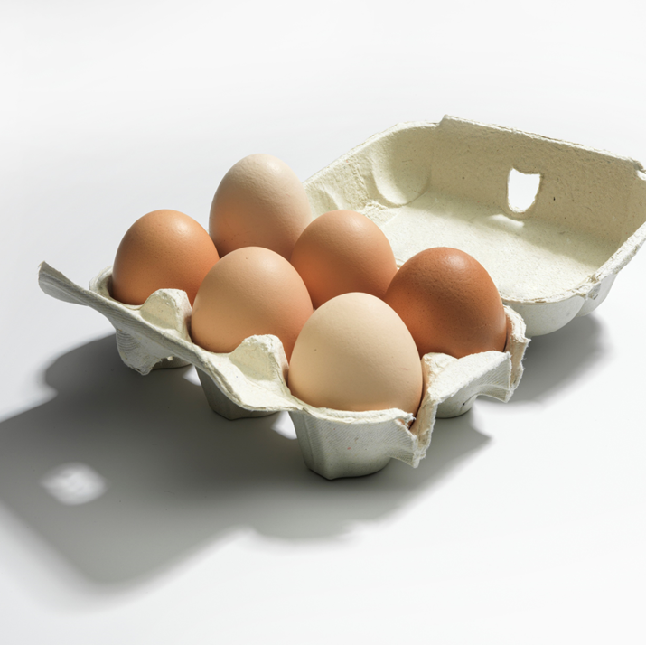
Sales Requirements
Washed
Graded and Sized according to USDA standards
Refrigerated (32 F to 45 F)
Packed in NEW cartons
Labeled

Slide 4
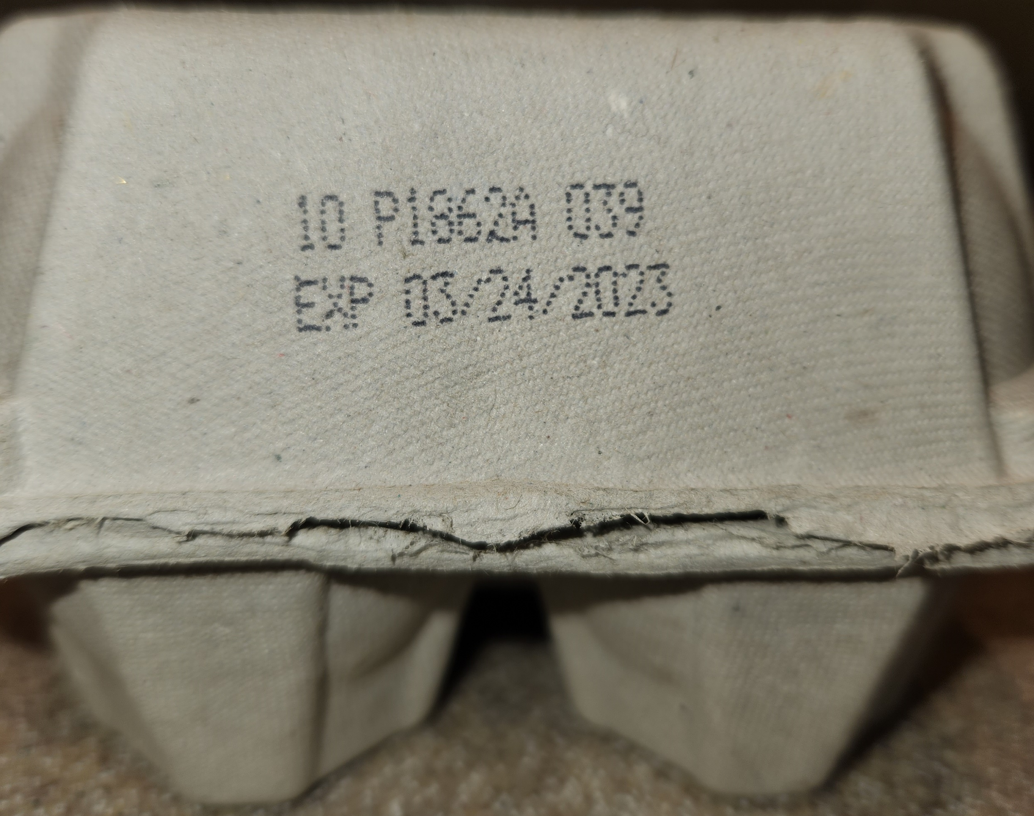
Label requirements
License Number or Plant Number
Pack Date (Julian Calendar)
Farm/Packer name and address
Oklahoma license number or USDA plant number
Grade and size (minimum guarantee)
Pack date and Expiration date (no more than 45 days from pack date)
Pack date in this example used a Julian date, you can use either a Julian date or a regular calendar date for the pack date
Expiration Date

Slide 5
Label Requirements
Refrigeration statement that says to keep at 45 F or below
Safe Handling Instructions: To prevent illness from bacteria: keep eggs refrigerated, cook eggs until yolks are firm and cook foods containing eggs thoroughly.

Slide 6
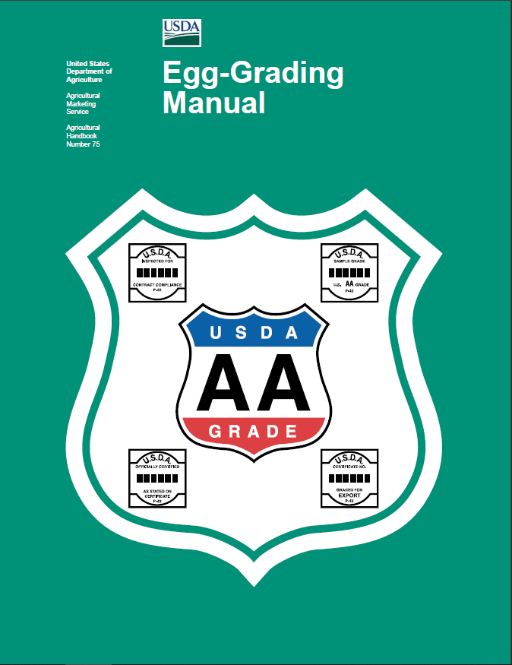
Grade and Size Guidance
USDA Egg Grading Manual
https://www.ams.usda.gov/sites/default/files/media/Egg%20Grading%20Manual.pdf
Videos: UGA Extension FFA Poultry Judging Class 7 and 8
https://youtu.be/GTzDrEYRDP4
https://youtu.be/v_G-6ENNNd8

Slide 7
Grades
This is a minimum guarantee to the quality and freshness of the egg
Grades can be AA, A, or B
Grade is determined by the shell and internal quality
Do not use the USDA grading symbol unless the eggs are officially graded by a USDA Egg Grader

Slide 8
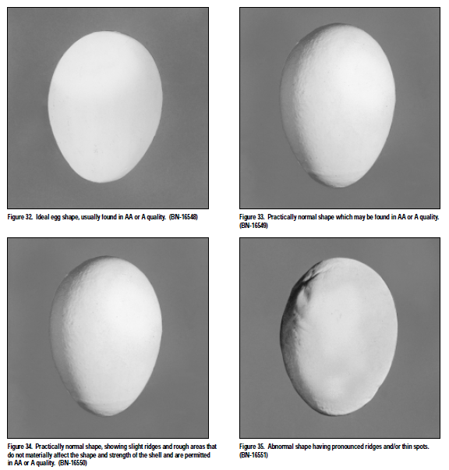
Shell Quality
AA and A
Normal shape
Only slight ridges, bumps
B
Abnormal shape
Bumps, ridges, thin spots
No grade
Cracks (checks)
Leaks
Dirty or prominent stain

Slide 9
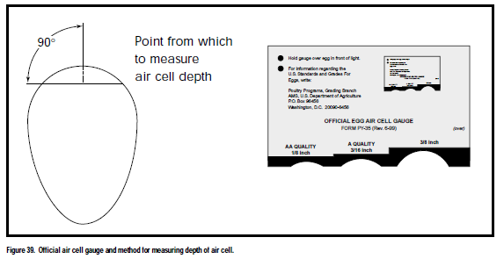
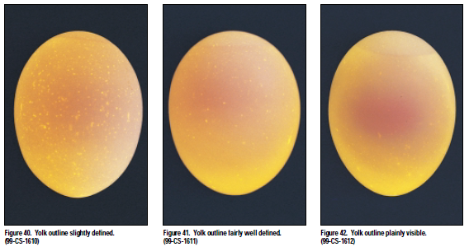
Internal Quality
AA
1/8” or less air cell
Yolk slightly defined
A
3/16” or less air cell
Yolk fairly defined
B
3/16” or larger air cell
Yolk outline plainly visible

Slide 10
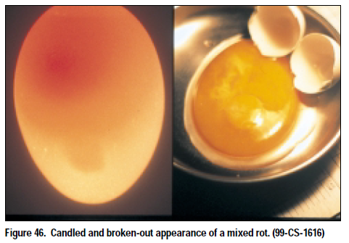
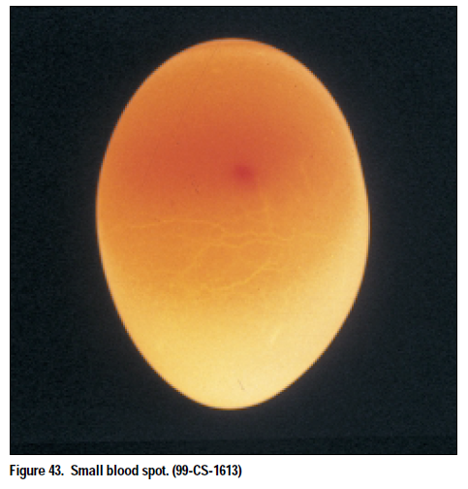
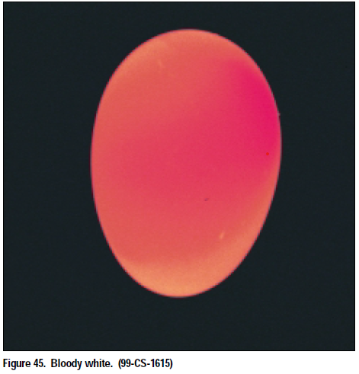
Defects: No Grade
Cracks (checks)
Leaks
Blood or meat spots
Bloody white
Stuck yolk
Mixed rot
Black rot

Slide 11
Sizes

Slide 12
Questions
Bryan Buchwald
405-522-5924
bryan.buchwald@ag.ok.gov

